Slide 1
Cryptographic Protocol Analysis and Verification
Members: Project Sponsor:
Juhi Patel Dr. Ed Zieglar Kunal Mangalorekar
Lizabeth Trevino
Nidhi Jawandhia

Slide 2
Overview
Introduction to Cryptographic Protocols
Introduction to CPSA and Dolev-Yao model
Introduction to 5G EAP TLS 1.2 & 1.3
Overview Our 5g EAP TLS 1.2 & 1.3 models
Analysis of generated CPSA shapes
Problems faced and Future Work

Slide 3
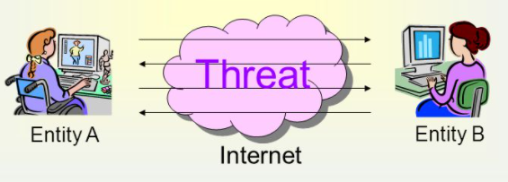
Introduction to Cryptographic Protocols
A set of rules that are designed to allow secure communication over an untrusted network such as the internet.
  No face-to-face interaction
  No way of knowing who you are talking to
Attackers can wreak havoc without proper cryptographic protocols in place.
  Man-in-the-middle, spoofing, etc.
Tools used in cryptographic protocols:
  Keys, authentications, encryptions, etc.
How do we know protocols are secure?

Slide 4
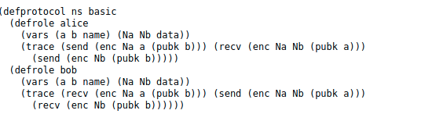
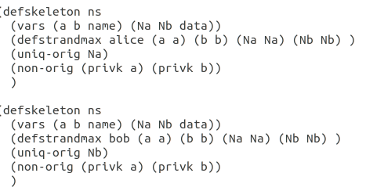
Introduction to CPSA (Cryptographic Protocol Shapes Analyzer)
Designed to assist in the design and analysis cryptographic protocols
Analysis is performed within a Dolev-Yao model
Input: Protocol definition and an execution skeleton(.lsp or .scm)

Slide 5
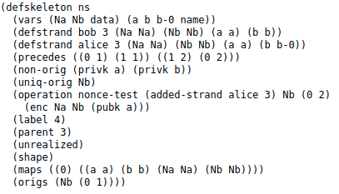
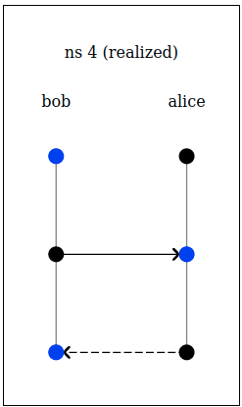
Introduction to CPSA (Cryptographic Protocol Shapes Analyzer)
Output: Runs all possible executions based on the description with the presence of the Dolev-Yao adversary (.xhtml)
Each enumeration is called a ‘shape’ of the protocol
CPSA is aimed to reveal only structural flaws in the protocol

Slide 6
Dolev-Yao model
Network:
Set of machines which can send/receive messages
Adversary assumed to be part of the network
Adversary:
Sniff, filter, intercept and modify any messages on the network.
Only limited by constraints of the cryptographic protocol used.

Slide 7
Introduction to 5G Authentication
Cellular Network technologies evolved over a period of time from 2G, 3G, 4G and now 3GPP is developing 5G.
Studies showed some catch in previous generation-
Lack of network authentication in 2G.
Lack of integration protection and confidentiality in certain signalling messages.
To mitigate these issues 3GPP defines an Authentication and Key Agreement protocol which is a challenge and response authentication protocol based on a symmetric key shared between subscriber and home network.

Slide 8
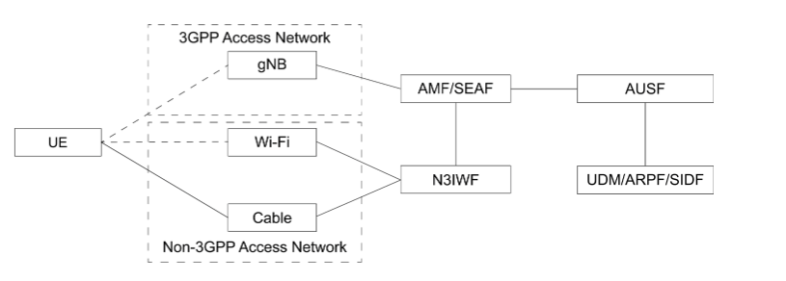
5G Authentication is designed in a manner that it is both open(support of Extensible Authentication protocol) and access network agnostic(network supporting 3GPP and for network not supporting 3GPP like wifi and cables).
Several security contexts can be established with one authentication execution, which allows the UE to move from a 3GPP access network to a non 3GPP network without reauthentication.

Slide 9
Working of the 5G EAP-TLS
EAP-TLS is defined in 5G subscriber authentication in limited use cases such as private networks and IOT environment.
When selected as authentication protocol, it is performed between the UE(EAP peer) and AUSF(EAP server) through Security Anchor Function(EAP pass through authenticator) by forwarding EAP-TLS messages back and forth.
Mutual Authentication is accomplished by verifying either each others certificate or pre shared key established during hand shaking.
At the end a key is derives and the first 256 bits is used to derive the other subsequent keys.

Slide 10
Difference between EAP TLS 1.2 and 1.3
TLS 1.3 offers several improvements over earlier versions.
Most notably a faster TLS handshake and simpler and more secure cipher suites.
Zero RTT(Round Trip Time) key exchanges further streamline the TLS handshake.
  If the client connected before, TLS 1.3 allows zero-roundtrip handshake.
  Server stores secret info from previous connections.
Though 0-RTT might have security implications
  Lack of full forward secrecy(like private certificate compromise)
  Possible replay attack issues
TLS 1.3 has mechanism to deal with both.
Together these changes provide better performance and stronger security

Slide 11
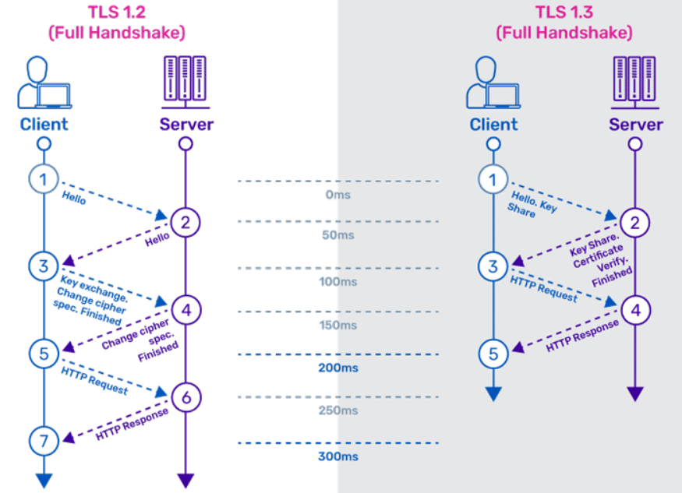

Slide 12
Difference between EAP TLS 1.2 and TLS 1.3
Features removed from EAP TLS 1.3
Static RSA handshake
CBC MtE modes
RC4
SHA1/MD5
Compression
Renegotiation
Features Added to TLS 1.3
Full Handshake signature
Downgrade Protection
Curve 25519 and 448
Abbreviated resumption

Slide 13
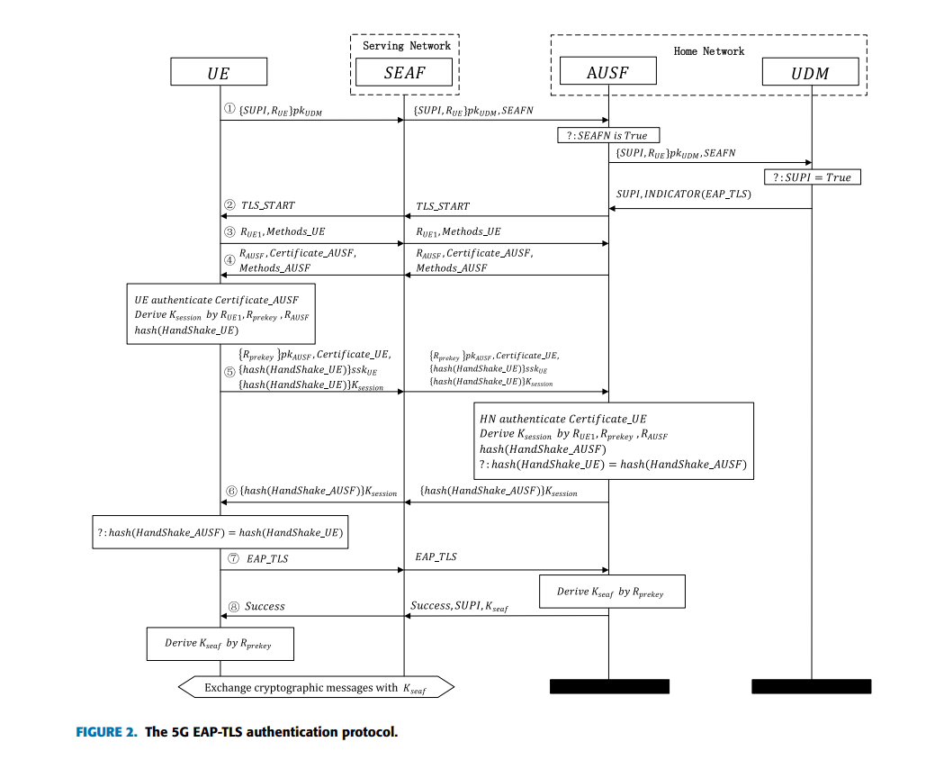
Our 5G EAP TLS 1.2 Model
Altered previous team’s 5G EAP-TLS 1.2 Model
  Added missing messages #7 & #8 to model
  Altered interpretation of the generation of the session key from concatenation of R_{UE} , R_{prekey}, R_{AUSF} to the hash of those values
Tried to fix the generation of multiple client (UE) and server (AUSF) instances

Slide 14
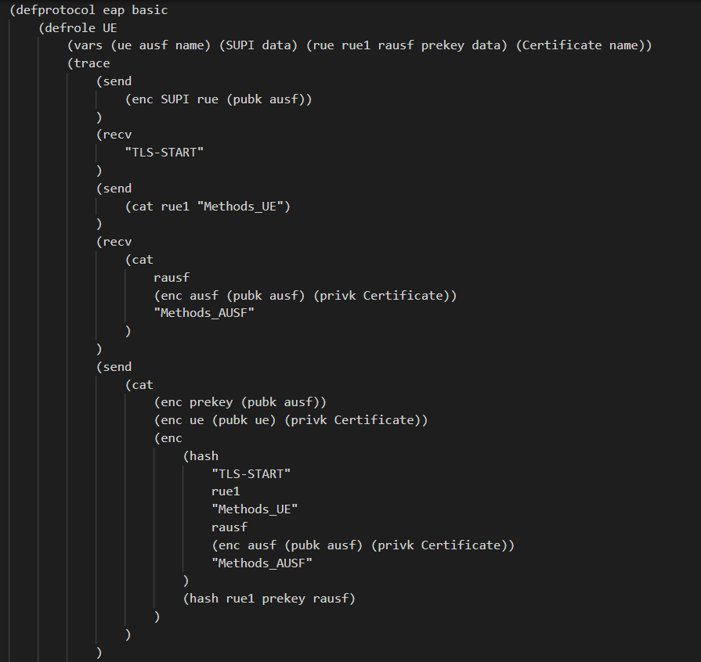
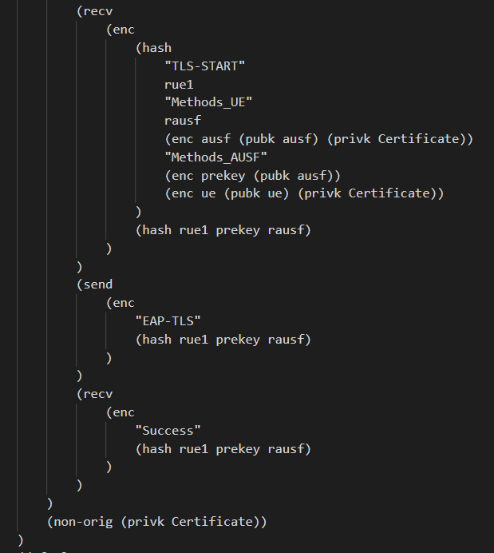
#7
#8
Session Key

Slide 15
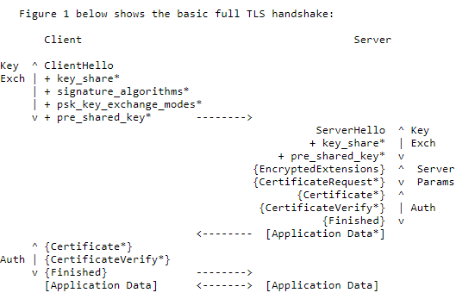
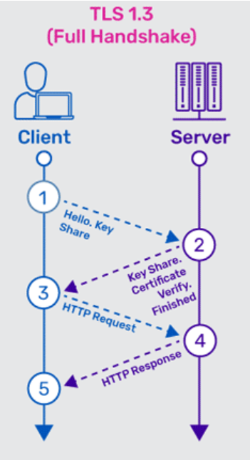
Our 5G EAP TLS 1.3 Model
Used our 1.2 Model as basis for 1.3
Replaced the TLS 1.2 handshake messages with one we modeled like the diagram
Version 1.3
  Model handshake word for word like Figure 1
  Didn’t produce any shapes that terminated the protocol properly
Version 1.3_1
  Abstracted components of ClientHello and ServerHello
  Produced a properly terminating shape, but also produced shapes that don’t terminate properly
Version 1.3_2 (Final Model)
  Changed one line of code( added non-orig for akey)
  Produce properly terminating shapes

Slide 16
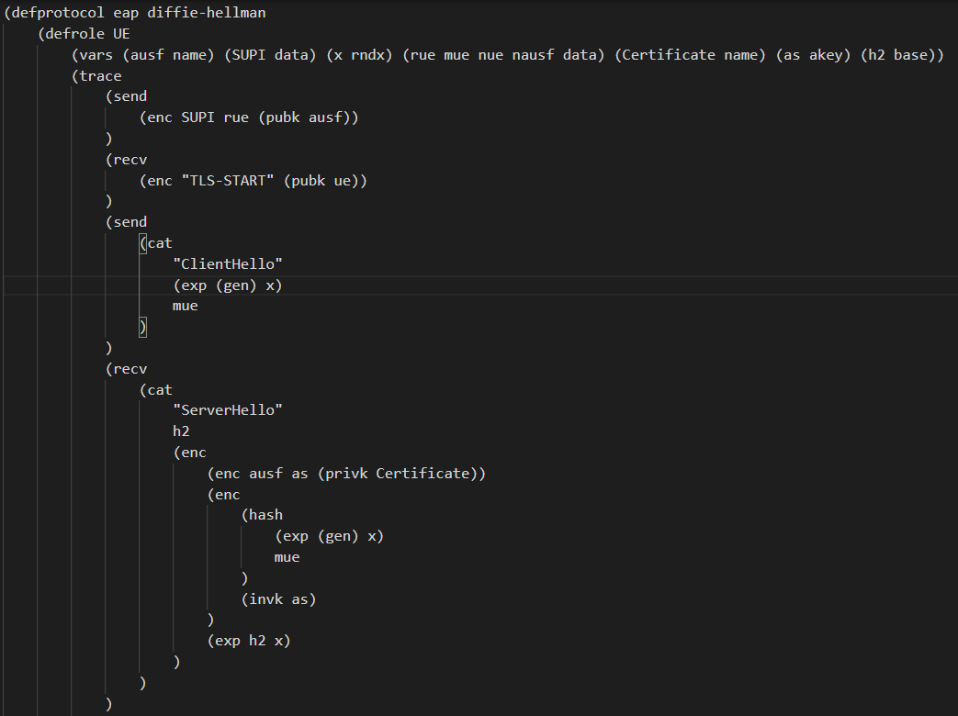
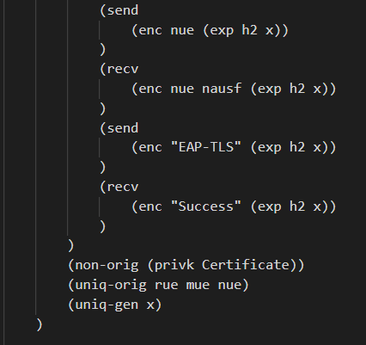
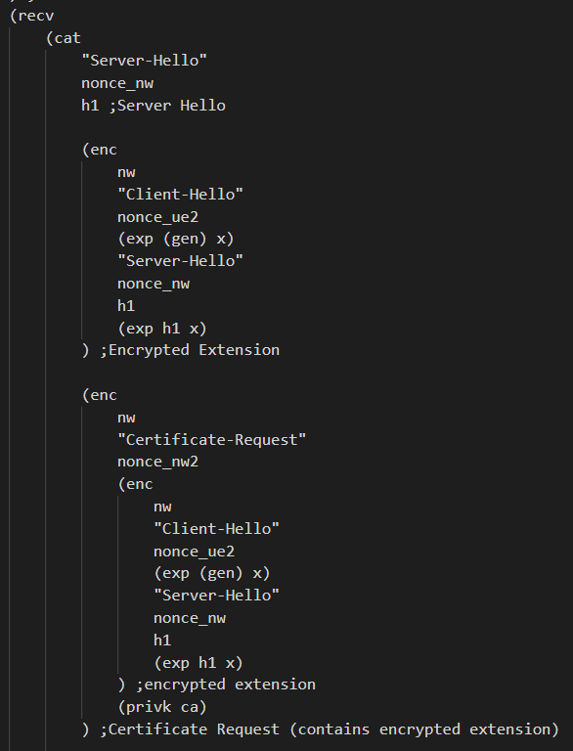
1.2 Model Base
1.2 Model Base
Version1.3
Version 1.3 Handshake message gets abstracted to the Version 1.3_1 message
Version 1.3_1

Slide 17
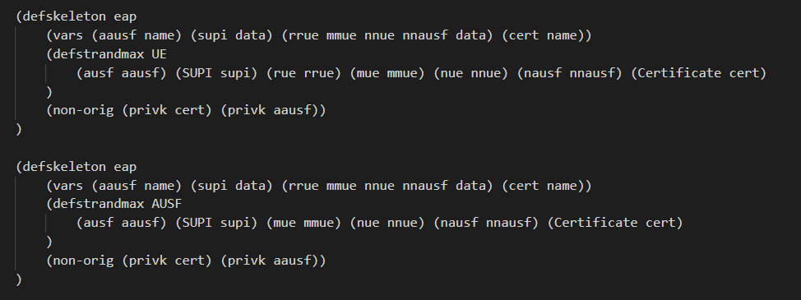
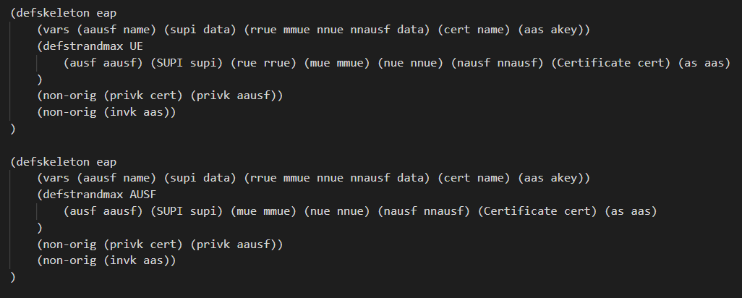
Version 1.3_1
Non-origination assumption for inverse of asymmetric key
Version 1.3_2
Non-origination assumption for inverse of asymmetric key

Slide 18
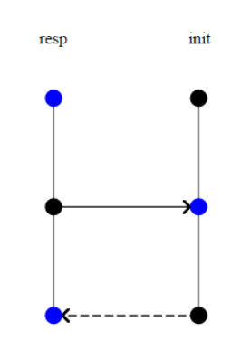
Interpreting Shapes in CPSA
Black node represents transmission of message from the node to network
Blue/Red nodes represent receptions of message from the network to the node.
Solid arrows indicate that messages are sent unaltered and can be satisfied(agreed) by the nodes (without adversary interference)
Dotted arrows indicate altered messages or the nodes do not agree on a particular value

Slide 19
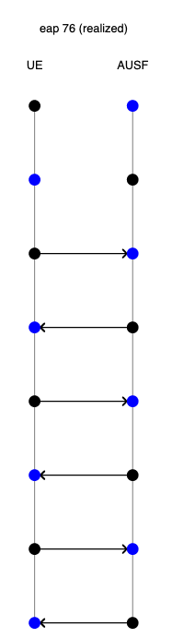
Analysis of EAP TLS v1.2
One shape completed successfully and securely completing the protocol from UE perspective.
Last 2 messages exchanged between UE and AUSF are communicated securely without adversary interference in all the completed shapes.
Implies that the session key generated and used for communication is not leaked to the adversary.

Slide 20
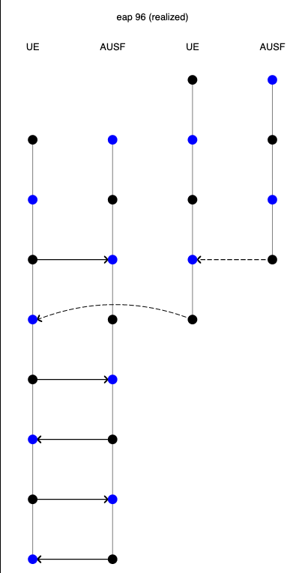
Analysis of EAP TLS v1.2
Multiple instances of UE and AUSF exchanging intermediate messages
Each new role spawned to send messages with new nonces
Last 2 messages exchanged are still completed without alterations

Slide 21
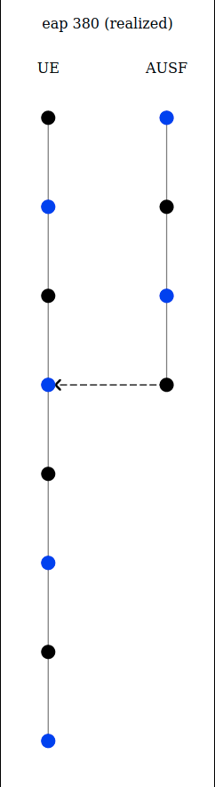
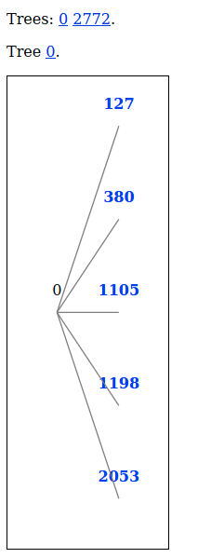
Analysis of EAP TLS v1.3_1
First Tree: Shapes could complete on their own without key exchange indication fault in the implementation/protocol
Private key used for signing had no origination assumption
Adversary could complete it from UEs perspective using this condition
Second Tree : AUSF completing the protocol by itself

Slide 22
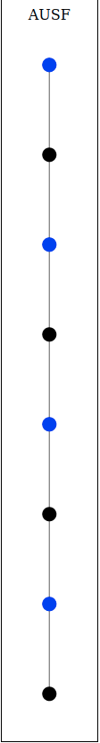
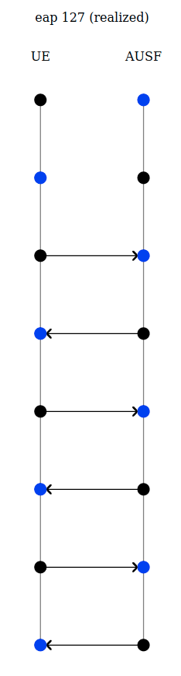
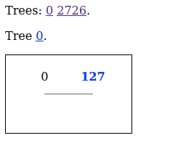
Analysis of EAP TLS v1.3_final
With correct origination assumption about private key
Two trees for two perspectives (UE and AUSF) skeletons.
First tree: UE (client) can successfully complete the protocol with AUSF
Second Tree: AUSF could complete the protocol by itself since its the server.
The protocol completed safely from UE(client) according to our implementation model with CPSA

Slide 23
Problems Faced
5g-EAP-TLS v1.3 has no formal research yet
  Difficult to abstract complicated messages
Computing resources
  CPSA could run for hours depending on the model specifications
CPSA language
  First-time users with little experience
  Difficult to diagnose issues at first

Slide 24
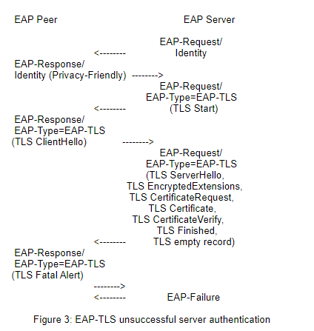
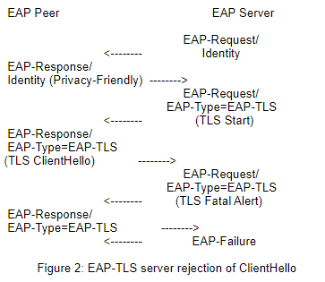
Future Work
Model different scenarios of 5G-EAP-TLS v1.3
  Eg. ClientHello, Failed Mutual Authentication, etc.
Find rules to restrict generation of roles in the 1.2 and 1.3 protocols
  Multiple instances of UE and AUSF

Slide 25
References
[1] A.T. Sherman, E. Lanus, M. Liskov, E. Zieglar, R. Chang, E. Golaszewski, R. Wnuk-Fink, C.J. Bonyadi, M. Yaksetig, and I. Blumenfeld, “Formal Methods Analysis of the Secure Remote Password Protocol,” Cyber Defense Lab, University of Maryland, Baltimore, MD, USA, 2020. Accessed: Feb. 9, 2021. [Online]. Available: https://arxiv.org/abs/2003.07421
[2] Doghmi, Shaddin F., et al. “Searching for Shapes in Cryptographic Protocols.” Tools and Algorithms for the Construction and Analysis of Systems, pp. 523–537., doi:10.1007/978-3-540-71209-1_41.
[3] J. Zhang, L. Yang, W. Cao and Q. Wang, "Formal Analysis of 5G EAP-TLS Authentication Protocol Using Proverif," in IEEE Access, vol. 8, pp. 23674-23688, 2020, doi: 10.1109/ACCESS.2020.2969474.
[4] Ramsdell, John D., Joshua D. Guttman, Jonathan K. Millen, and Brian O'Hanlon. "An analysis of the CAVES attestation protocol using CPSA." arXiv preprint arXiv:1207.0418 (2012).
[5] Lucca Hirschi, Ralf Sasse, Jannik Dreier. Security Issues in the 5G Standard and How Formal Methods Come to the Rescue. ERCIM News, ERCIM, 2019. Hal-02268822
[6] Liskov, M. D., Ramsdell, J. D., Guttman, J. D., & Rowe, P. D. (2016). The Cryptographic Protocol Shapes Analyzer: A Manual. The MITRE Corporation.

Slide 26
Questions?

